Slide 1

SKKU TAXI
명륜 ~ 율전 캠퍼스 간 택시 합승 모바일 어플리케이션 서비스
MG 세대(G조) - 권우진, 김재현, 박지수, 이채은

Slide 2


Problems
There is demand for transportation between campuses during times when shuttle service is unavailable or late hours.
While public transportation is available during certain hours, it often requires long travel times and transfers, making it less convenient compared to using the campus shuttle service.
However, taking a taxi alone can be expensive, and some students may feel uneasy about riding a taxi by themselves late at night.
2

Slide 3


Solving
Develop an application that allows students to schedule rides in advance for transportation between campuses using taxis.
3

Slide 4
Functions
Post a recruitment message containing the taxi pick-up time, meeting location, and travel direction.
Other users with similar travel needs join the recruitment post.
For safety, users are required to complete identity verification during the registration process.
4

Slide 5
Specs
Develop
Type | Language | Frameworks
Backend | Javascript, Typescript | Nestjs
Frontend (application) | Dart | Flutter
Production
Type | Env | etc
Backend | AWS | LINC 3.0 지원금 사용
Frontend (application) | Marketplace
5

Slide 6
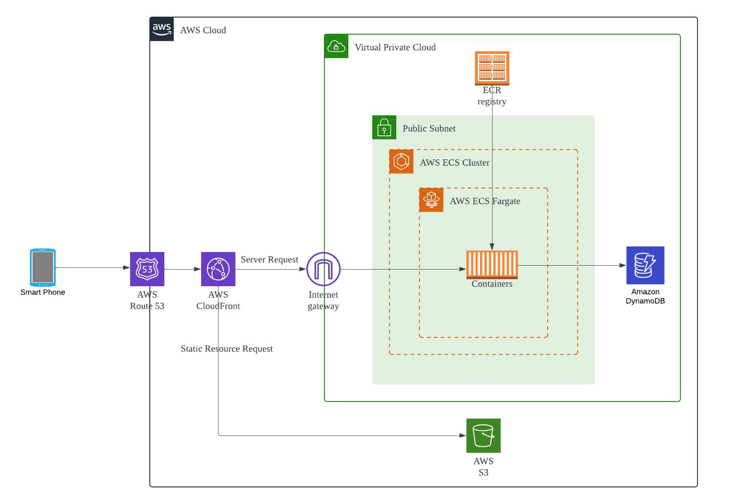
Infrastructure Blueprint
6

Slide 7
Thank you

